Slide 1
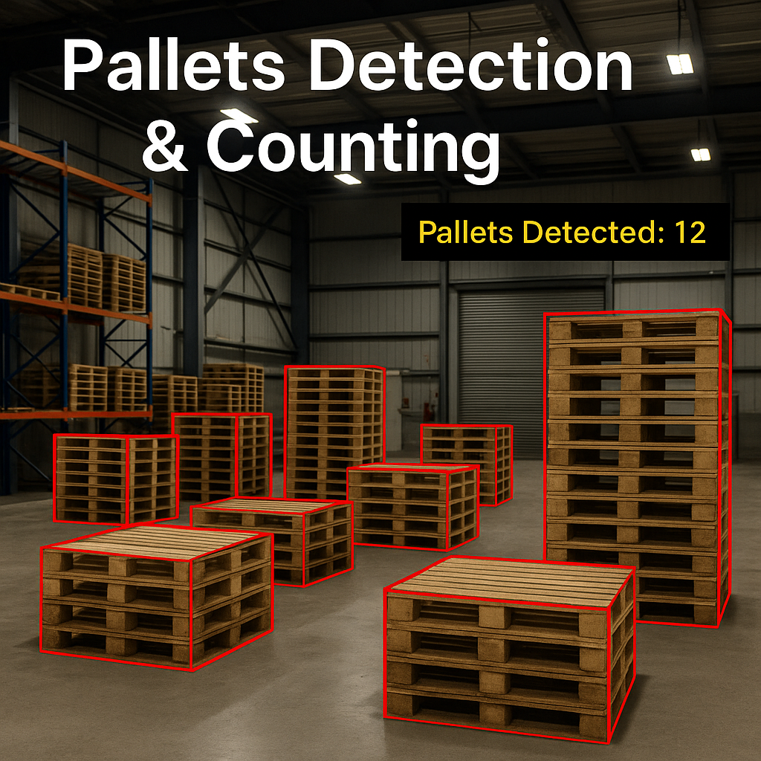


Slide 2


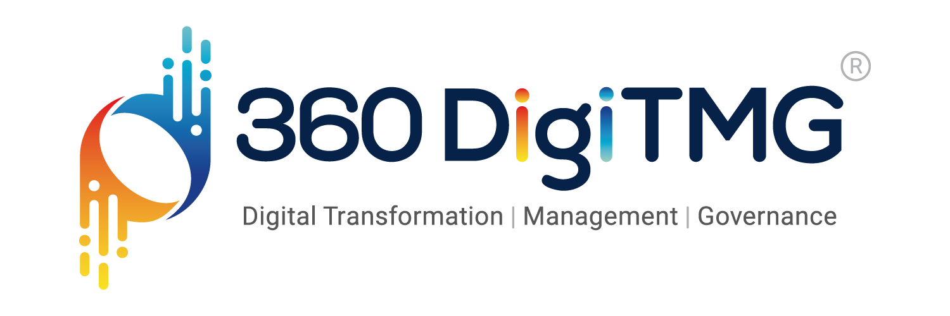
Team Members
Name:Kunal Borase
https://www.linkedin.com/in/kunal-borase-9258b21a1/overlay/photo/
Name:Mandeep Singh Thakur https://www.linkedin.com/in/kunal-borase-9258b21a1/overlay/photo/

Slide 3

CONTENTS
BUSINESS OBJECTIVE
BUSINESS CONSTRAINTS
BUSINESS SUCCESS CRITERIA
PROJECT WORKFLOW
PROJECT ARCHITECTURE
DATA COLLECTION
DATA PREPROCESSING
PROJECT CHALLENGES
CONCLUSION

Slide 4
BUSINESS PROBLEM
A leading global pallet manufacturing company faces inventory challenges due to inaccurate counting of stacked pallets in warehouses. Manual and semi-automated methods are inefficient, causing stock discrepancies, delays, and higher costs. Traditional scanning fails to track stacked pallets, impacting real-time visibility, order fulfillment, and logistics. As operations grow, a precise and efficient inventory management solution is crucial.

Slide 5
OBJECTIVE:
Minimize the latency of count and Maximize Precision accuracy.
CONSTRAINT:
Minimize Processing Time.

Slide 6
SUCCESS CRITERIA
Business Success Criteria: Achieve 25% reduction in overall warehouse operational costs, including labor and counting inefficiencies.
Machine Learning Success Criteria: Achieve at least 95% model accuracy with an inference time of ≤1 second per frame.
Economic Success Criteria: Achieve 30% reduction in operational costs, including labor and inventory loss.

Slide 7
There are six stages of CRISP-ML(Q) Methodology
1.Business and data understanding
2.Data preparation
3.model building
4.Model evaluation
5.Model deployment
6.Monitoring and maintenance
CRISP-ML(Q) Methodology

Slide 8
PROJECT WORKFLOW
IMAGE COLLECTION & PREPROCESSING
IMAGE ANNOTATION & DATA AUGMENTATION
OBJECT DETECTION
MODEL BUILDING
MODEL DEPLOYMENT
ANALYSIS & MONITORING

Slide 9
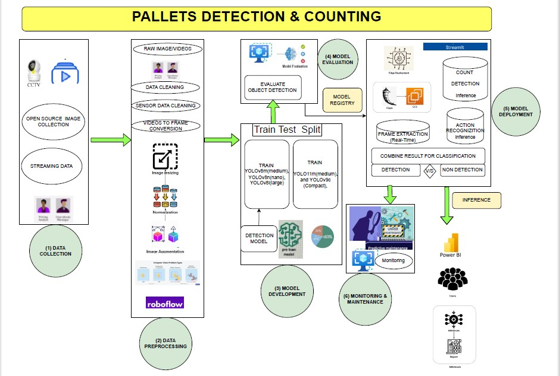
PROJECT ARCHITECTURE-HIGH LEVEL

Slide 10
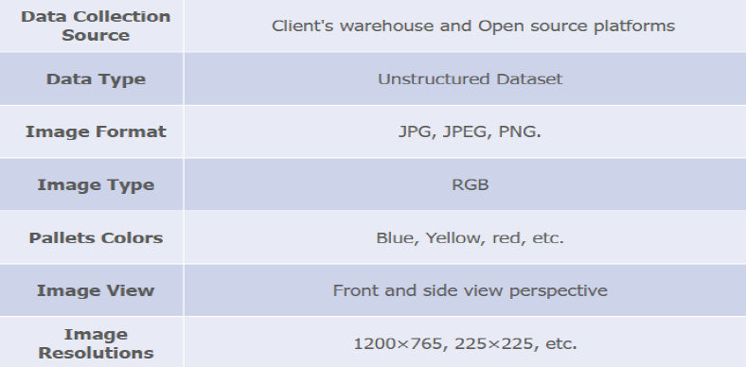
IMAGE COLLECTION & PREPROCESSING:
COLLECTED 50 PALLET IMAGES &
150 PALLET IMAGE FROM THE CLIENT SIDE.
ANNOTATION WITH ROBOFLOW:
ANNOATED EACH STACK PALLET WITH BOUNDING BOX.

Slide 11
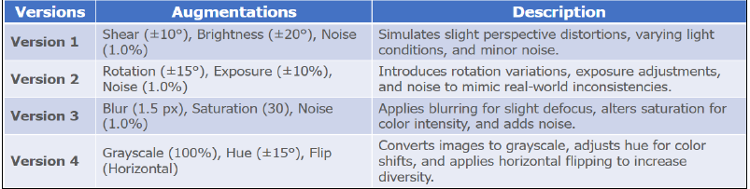
DATA AUGMENTATION
TECHNIQUES USED:
  ROTATION, SCALING, FLIPPING.
  BRIGHTNESS/CONTRAST ADJUSTMENT
  ADDING NOISE, SHEAR TRANSFORMATION
  EACH IMAGE AUGMENTED 3 TIMES TO IMPROVE MODEL PERFORMANCE

Slide 12
MODEL SELECTION

Slide 13
WHY YOLO MODELS?
✅ HIGH EFFICIENCY & REAL-TIME PALLET DETECTION
✅ ROBUST FEATURE EXTRACTION FOR COMPLEX BACKGROUNDS
MODELS TRAINED & RESULTS:
YOLOv5s (Epochs: 50) → mAP@0.5: 84.2%
YOLOv7 (Epochs: 75) → mAP@0.5: 88.7%
YOLOv8n (Epochs: 100) → mAP@0.5: 85.9%
YOLOv8l (Epochs: 100) → ✅ Best Performance → mAP@0.5: 91.3%, mAP@0.5:0.95: 72.4%

Slide 14
MODEL DEPLOYMENT

Slide 15
DEPLOYMENT WITH STREAMLIT
WHY STREAMLIT?
  LIGHTWEIGHT & INTERACTIVE WEB-BASED UI
FEATURES IMPLEMENTED:
  UPLOAD IMAGES (JPG, PNG)
  REAL-TIME OBJECT DETECTION & POSE ESTIMATION
  COMPLIANCE STATUS DISPLAY

Slide 16
CONCLUSION
SUCCESSFULLY IMPLEMENTED AI-POWERED COMPLIANCE MONITORING.
AUTOMATED REAL-TIME SAFETY TRACKING
DEPLOYMENT ENABLES EASY WORKPLACE MONITORING

Slide 17
PROJECT
CHALLENGES

Slide 18
1. DATA COLLECTION CHALLENGES
LIMITED DATASET: COLLECTING ENOUGH HIGH-QUALITY STACK PALLETS IMAGES CAN BE DIFFICULT.
DIVERSITY OF WORK ENVIRONMENTS: DIFFERENT WORKPLACES HAVE VARYING LIGHTING CONDITIONS, ANGLES, AND SAFETY PROTOCOLS.
VIDEO FRAME EXTRACTION ISSUES: EXTRACTING MEANINGFUL FRAMES FROM VIDEOS WHILE AVOIDING REDUNDANCY OR BLURRINESS.

Slide 19
2. ANNOTATION AND LABELING CHALLENGES
MANUAL EFFORT: ANNOTATING IMAGES IN ROBOFLOW IS TIME-CONSUMING.
CLASS IMBALANCE:
SOME SAFETY GEAR ITEMS (E.G., GLOVES, GOGGLES) MIGHT APPEAR LESS FREQUENTLY, LEADING TO BIASED MODEL PERFORMANCE.
COMPLEX SCENES:
MULTIPLE WORKERS AND OVERLAPPING OBJECTS CAN MAKE ANNOTATION DIFFICULT

Slide 20
3. MODEL TRAINING CHALLENGES
COMPUTATIONAL REQUIREMENTS: Training pallet detection models like YOLOv7 requires high GPU resources, increasing infrastructure costs and deployment time.
HYPERPARAMETER TUNING: FINDING THE BEST LEARNING RATE, BATCH SIZE, AND EPOCH COUNT FOR OPTIMAL PERFORMANCE.
FALSE POSITIVES & FALSE NEGATIVES: MODEL MIGHT DETECT PALLETS INCORRECTLY, LEADING TO INACCURATE INVENTORY COUNTS AND AFFECTING STOCK VISIBILITY AND LOGISTICS DECISIONS.

Slide 21
5. DEPLOYMENT CHALLENGES (STREAMLIT)
LATENCY ISSUES: REAL-TIME OBJECT DETECTION MAY SLOW DOWN DUE TO LARGE IMAGE SIZES.
USER-FRIENDLY INTERFACE: ENSURING A SIMPLE AND INTERACTIVE UI FOR NON-TECHNICAL USERS.
INTEGRATION WITH EXISTING SYSTEMS:
MANY COMPANIES HAVE LEGACY SAFETY MONITORING SYSTEMS THAT NEED SEAMLESS INTEGRATION.

Slide 22
6. BUSINESS & ECONOMIC CHALLENGES
ADOPTION RESISTANCE: EMPLOYEES MAY RESIST AI-BASED MONITORING DUE TO PRIVACY CONCERNS.
COST CONSTRAINTS: BALANCING MODEL ACCURACY WHILE KEEPING DEPLOYMENT AND MAINTENANCE COSTS LOW.
REGULATORY COMPLIANCE: ENSURING THAT AI MONITORING ADHERES TO WORKPLACE SAFETY REGULATIONS AND LABOR LAWS.

Slide 23
CONCLUSION
AI-driven pallet detection ensures real-time inventory precision.
Results in significant cost savings and operational efficiency.
Scalable and adaptable for future warehouse expansion.

Slide 24

IF YOU HAVE ANY QUESTIONS OR NEED FURTHER CLARIFICATION, FEEL FREE TO ASK.
PROJECT LEAD: Kunal G. Borase
PRESENTED BY:Mandeep Singh Thakur

